Slide 1
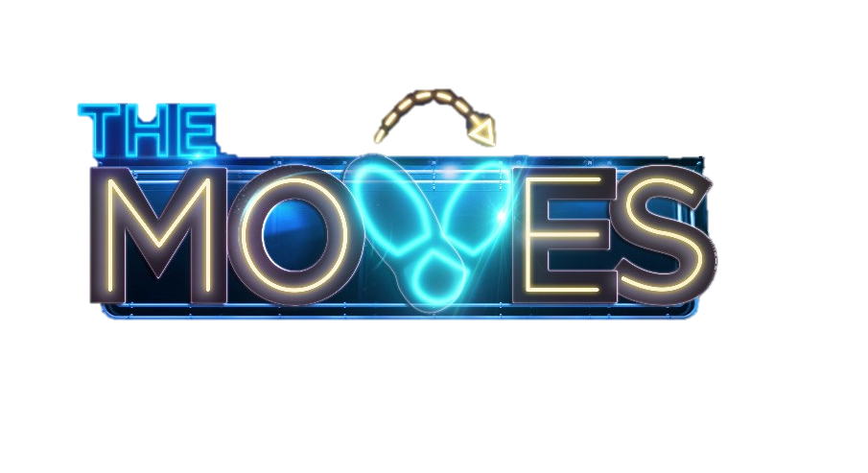
Prime Time Studio Entertainment
60 - 90 mins
Producer: Armoza Formats
Real people, inspirational stories
Close-ended episodes
Cost-effective production
Viral potential
This fun and emotional studio entertainment format will inspire anyone and everyone to bust a move! Breaking the mold of traditional dance formats, The Moves highlights that while everyone loves to dance, not everyone has the moves. In each episode 4 all-star dance coaches go head-to-head to prove who can give the most amazing dance makeover of the night. Potential participants, who want and need a dance makeover, showcase their moves for our dance coaches. From a 60-year-old grandpa who wants to bust a move with his grandkids to a shy overweight teen who would like to break out of her shell, each episode brings a variety of fun and relatable characters and stories. After showcasing their talents, the coaches will pick the contestant who had the moves they can work with. In the second half of the episode, we will meet each team in the studio as they reveal their makeovers in front of a live audience, family and friends. The episode ends as the audience decides which coach brought the winning moves.
DANCE LIKE EVERYONE’S WATCHING!

